Slide 1




Data
Culture
society
@edCDCS
Notes:
MT

Slide 2


Introduction to Text Analysis With Python
16 & 25 Feb 2026
Instructor: Joy Lan
Adapted from materials made by Xandra Dave Cochran
Notes:
MT

Slide 3
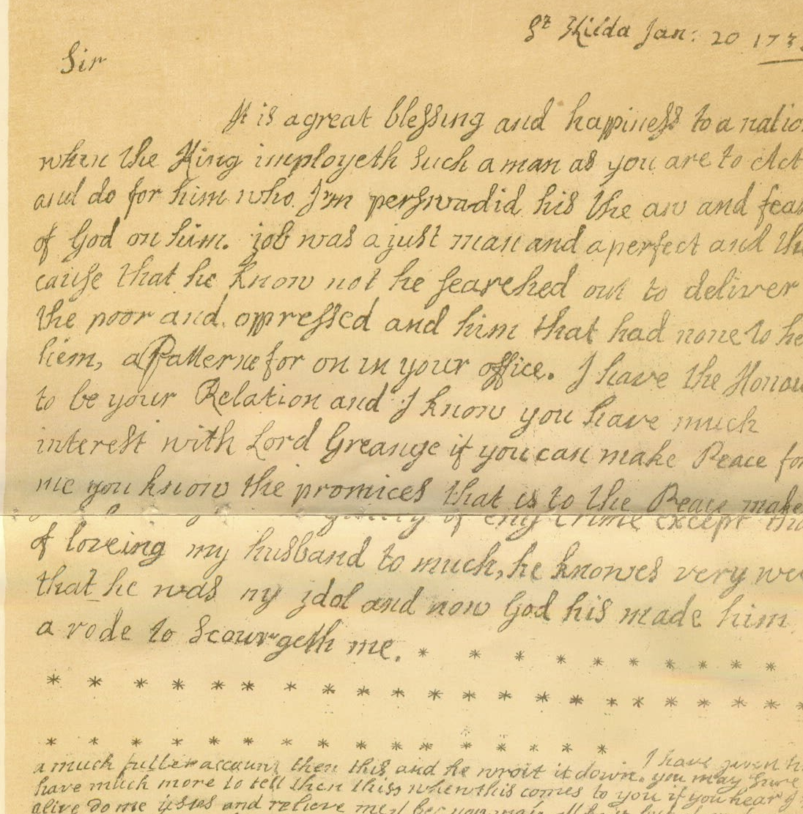

Course Topic
Analysing unstructured data with Python
Natural Language Toolkit (NLTK)
Regular Expressions
www.cdcs.ed.ac.uk

Slide 4
Course Structure
Anticipate about ~4 hours/week
2 hour course, 2-4 pm on Monday
Independent learning, ~2 hours
Office hours on request on Teams
All materials will be uploaded to the course page on Github
www.cdcs.ed.ac.uk

Slide 5
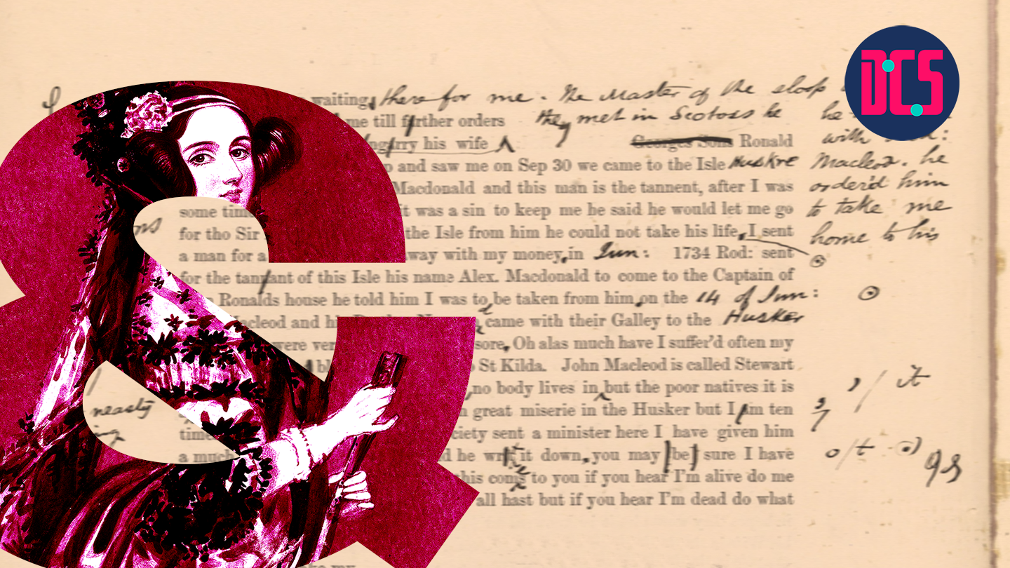
Introduction
Why are you interested in text analysis?
Have you used Python before?
Have you used Jupyter Notebooks or Google Colab before?
Have you used Regular Expressions before?
Have you used NLTK before?
www.cdcs.ed.ac.uk

Slide 6

Set up the environment
Jupyter Notebooks / Jupyterlabs
With Google Colab https://colab.research.google.com
Go to File > Open Notebook > Github> paste the Github link to the notebook
Locally
Install jupyter notebook with pip/pip3 or conda
Download and open the notebook file
You’ll also need to install the libraries (nltk, etc. ) locally
www.cdcs.ed.ac.uk

Slide 7
Python Refresher (Opt.)
Name these data types:
”Hello!”
[1, 2, 3]
{”A”:1, “B”:2}
Functions:
print()
while:
for i in list:
def function_name()
www.cdcs.ed.ac.uk

Slide 8
Download and Import nltk packages
Import ntlk
Use nltk.download() for downloading the packages, once they are downloaded, you can call these packages using "import”
We will use nltk ‘gutenberg' and 'book’ as example corpus (textual data)
www.cdcs.ed.ac.uk

Slide 9
Getting to Know a Text

Slide 10
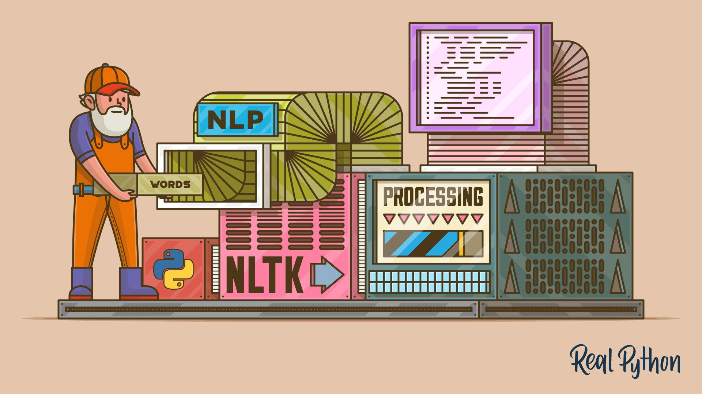
Data Source
Examples of data sources for natural language:
• Books
• Newspapers
• Magazines
• Websites
• Transcriptions of audio (i.e. interview, movie dialogue)
• Social media (memes)
Always read the licensing/copyright information and terms of use!
www.cdcs.ed.ac.uk

Slide 11
Demo 1
Use built-in functions to print out and summarise text1, and text2
www.cdcs.ed.ac.uk

Slide 12
NLP Natural Language Processing
What kinds of questions can you ask when you can use a programming language to study hundreds, thousands, or even millions of pages of digital text?
“Distant reading”
www.cdcs.ed.ac.uk

Slide 13
Why use NLTK
What kinds of questions can you ask when you can use a programming language to study hundreds, thousands, or even millions of pages of digital text?
“Distant reading”
NLTK Isn’t everything
What kinds of questions can you ask when you can physically hold and look at a printed text, be it an original publication or later edition of the text?
“Close reading”
Book history
www.cdcs.ed.ac.uk
Notes:
Building capacity in the Digital Humanities
The Digital Research Infrastructure for the Arts and Humanities (DARIAH) aims to enhance and support digitally-enabled research and teaching across the arts and humanities. DARIAH is a network of people, expertise, information, knowledge, content, methods, tools and technologies from its member countries. It develops, maintains and operates an infrastructure in support of ICT-based research practices and sustains researchers in using them to build, analyse and interpret digital resources. By working with communities of practice, DARIAH brings together individual state-of-the-art digital arts and humanities activities and scales their results to a European level. It preserves, provides access to and disseminates research that stems from these collaborations and ensures that best practices, methodological and technical standards are followed.

Slide 14
Text Represented by ?
In human language, text is represented by a collections of words, or sentences.
In NLTK, similarly, text is represented by tokens, unique word.
Each token is link to a numerical representation, such as a number.
Example:
the dog is eating, and the cat is eating. (9 words)
Tokens: 0:the, 1:dog, 2:is, 3:eating, 4:”,” , 5:and, 6:cat, 7:”.” (8 tokens)
www.cdcs.ed.ac.uk

Slide 15


Tokenisation
Tokenisation involves breaking down a piece of text into smaller units called tokens.
Tokens can be individual words, sentences, or even characters, depending on the level of granularity desired.
Tokenisation helps in standardizing and organizing text data, making it easier to analyse and process.
Word-based tokenisation breaks down text into individual words, treating each word as a separate token.
www.cdcs.ed.ac.uk

Slide 16
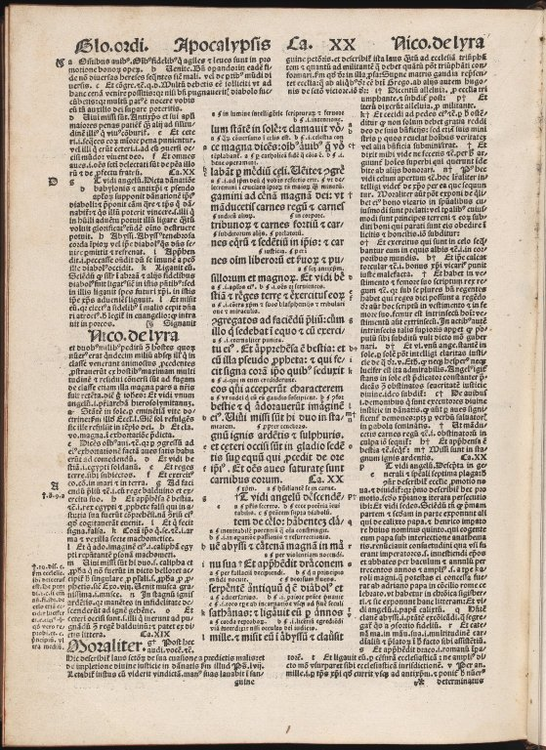
Getting to Know a Text
We can use Python built-in functions such as
len(text)
set(text)
Reference: https://www.nltk.org/book/ch01.html
Biblia Sacra by N/A - University of Edinburgh, United Kingdom - CC BY.
https://www.europeana.eu/item/9200261/BibliographicResource_3000058482943
www.cdcs.ed.ac.uk

Slide 17
Demo 2
Calculate the following measures of text1 and text 2
length of vocabulary
lexical diversity (the number of tokens/the length of text)
www.cdcs.ed.ac.uk

Slide 18
Getting to Know a Given Word in a Text
NLTK Text methods include:
Text.concordance("word", lines=20)
Text.similar("word")
Text.common_contexts(["list", "of", "words"])
Text.dispersion_plot(["list", "of", "words"])
www.cdcs.ed.ac.uk

Slide 19
Demo 3-4
Get the context of a given word
Get similar words of a given word
Get the common context of a list of words
Plot the appearance of a given word across the document
www.cdcs.ed.ac.uk

Slide 20
Demo 5
Using context of words and similar words to gain insight to the the relation between given words. (ex. good, opinion)
Bigram and N-gram
www.cdcs.ed.ac.uk

Slide 21
Customise Tokenization

Slide 22
Text Cleaning and Pre-processing
Text cleaning and pre-processing:
remove unwanted characters (https:// , emojis, etc.)
Normalisation:
Lowercasing
Stemming and lemmatizing
Stopword removal: remove words that don’t add meaning to the data
Tokenization: split documents into words/punctuation, or sentences
POS Tagging (Part-of-Speech Tagging): assigns grammatical labels to each token.
Bigram, N-gram
www.cdcs.ed.ac.uk

Slide 23
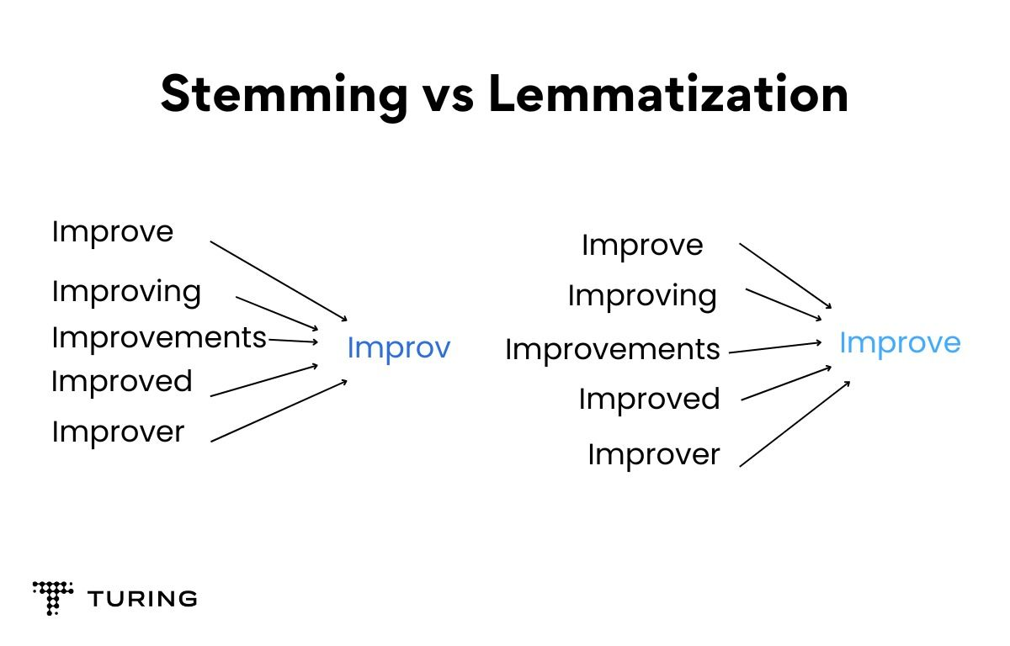
Stemming & Lemmatization
www.cdcs.ed.ac.uk

Slide 24
Demo 6
Use word and sentence tokenizers
Normalise text using word.lower()
Stemming and Lemmatisation
www.cdcs.ed.ac.uk

Slide 25
Stopwords
Stopwords include words like “a,” “the,” “of,” “an” that don’t add meaning to the dataset.
I am going to the shop. -> “I”, “going”, “shop”
www.cdcs.ed.ac.uk

Slide 26
Demo 7
Apply stopword removal
www.cdcs.ed.ac.uk

Slide 27
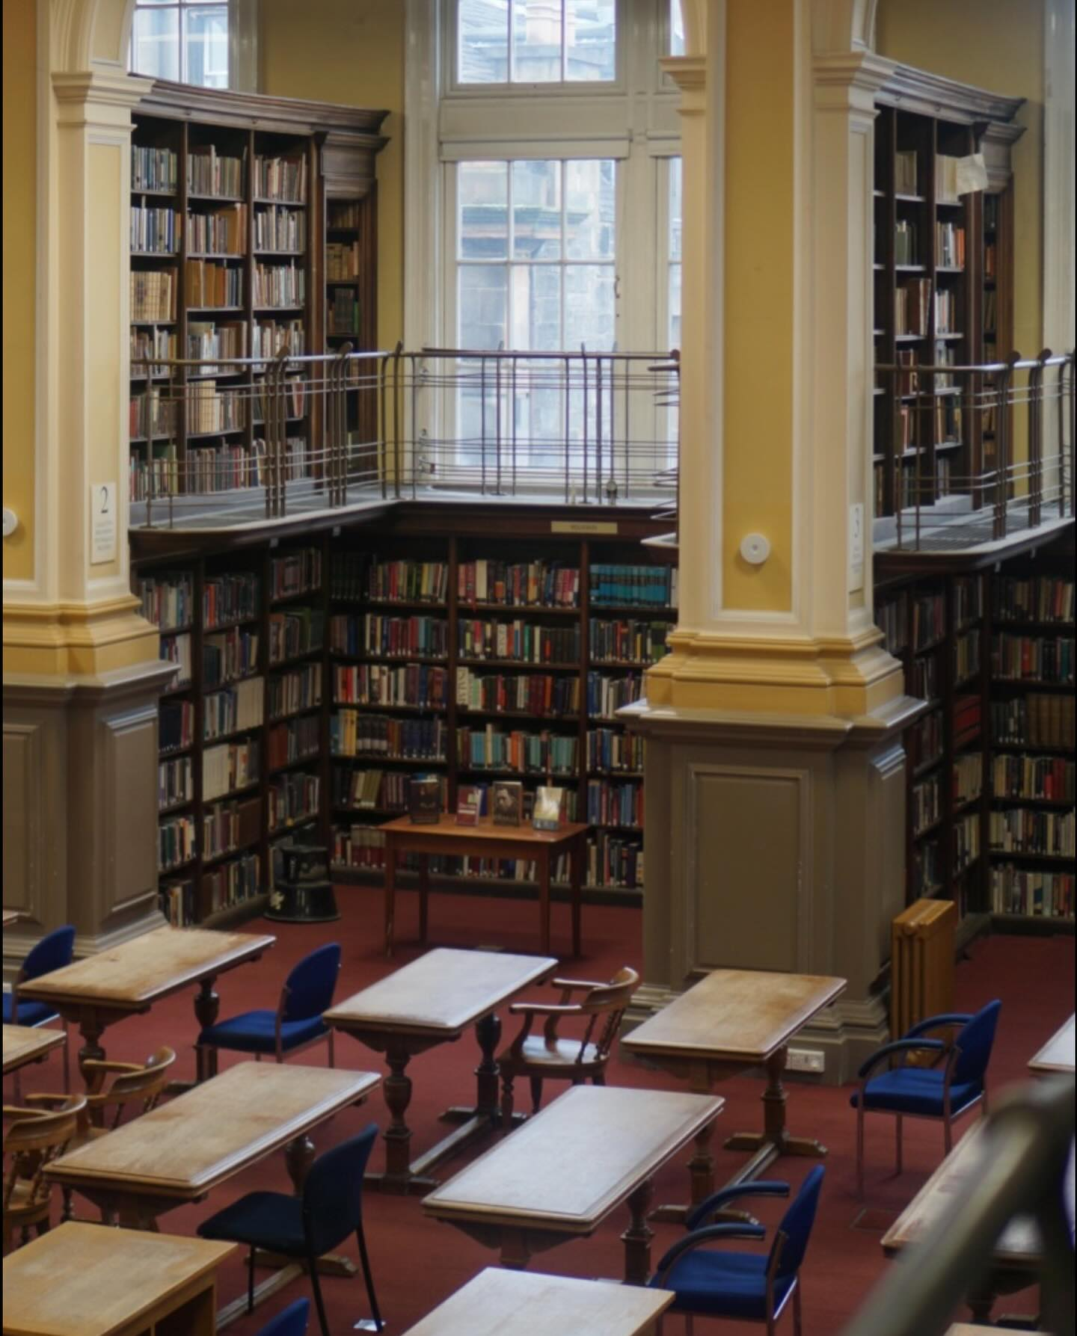
Finding Text Sources
Libraries - NLS Data Foundry (data.nls.uk)
Project Gutenberg (gutenberg.org)
Hathi Trust Digital Library (hathitrust.org)
Websites - Internet Archive (archive.org)'s Wayback Machine, UK Web
archive (webarchive.org.uk)
Newspaper archives (universities often subscribe to them!)
www.cdcs.ed.ac.uk

Slide 28
Research with NLTK
Who is named in a text?
What places are named in a text?
Chunking and Named Entity Recognition
How does the vocabulary of an author change over time?
Lexical Diversity
www.cdcs.ed.ac.uk

Slide 29
Research with NLTK
What are the common themes throughout a corpus?
Topic Modeling
What attitudes are expressed in a corpus?
Sentiment Analysis
What words occur near each other throughout a corpus? How does the meaning of a word change over time?
Word Embeddings
www.cdcs.ed.ac.uk

Slide 30
Next Week
Research with NLTK on a corpus
NLTK with pandas (for tabular data)
NLTK with Altair (for data visualization)
Regular Expression practice
Cleaning messy text
Resources for more text analysis practice
www.cdcs.ed.ac.uk

Slide 31
Thanks Everyone!
Next class: Monday 25th, 2-4PM
Please message me on Teams for office hours!

